Slide 1
P.Julia Mary
Assistant Professor
Department of Mathematics -Shift II

Slide 2

FUNDAMENTALS OF
MATHEMATICAL
STATISTICS

Slide 3
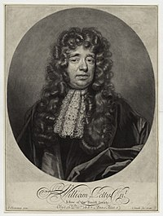
HISTORY OF STATISTICS
In 1786 William Playfair (1759-1823) introduced the idea of graphical representation into statistics. He invented the line chart, bar chart and histogram and incorporated them into his works on economics, the Commercial and Political Atlas.

Slide 4

a fact or piece of data obtained from a study of a large quantity of numerical data IS CALLED STATISTICS . Branch of mathematics concerned with collection, classification, analysis, and interpretation of numerical facts, for drawing inferences on the basis of their quantifiable likelihood (probability).
Statistics can interpret aggregates of data too large to be intelligible by ordinary observation because such data (unlike individual quantities) tend to behave in regular, predictable manner

Slide 5

CONTENT:
PROBABILITY
RANDOM VARIABLES AND DISTRIBUTION FUNCTIONS
CORRELATION
X DISTRIBUTION
t , f and z DISTRIBUTION
TEST OF HYPOTHESIS
2

Slide 6

PROBABILITY
Probability is the measure of the likelihood that an event will occur . Probability is quantified as a number between zero and one . where, loosely speaking, zero indicates impossibility and one indicates certainty . The higher the probability of an event, the more likely it is that the event will occur.

Slide 7
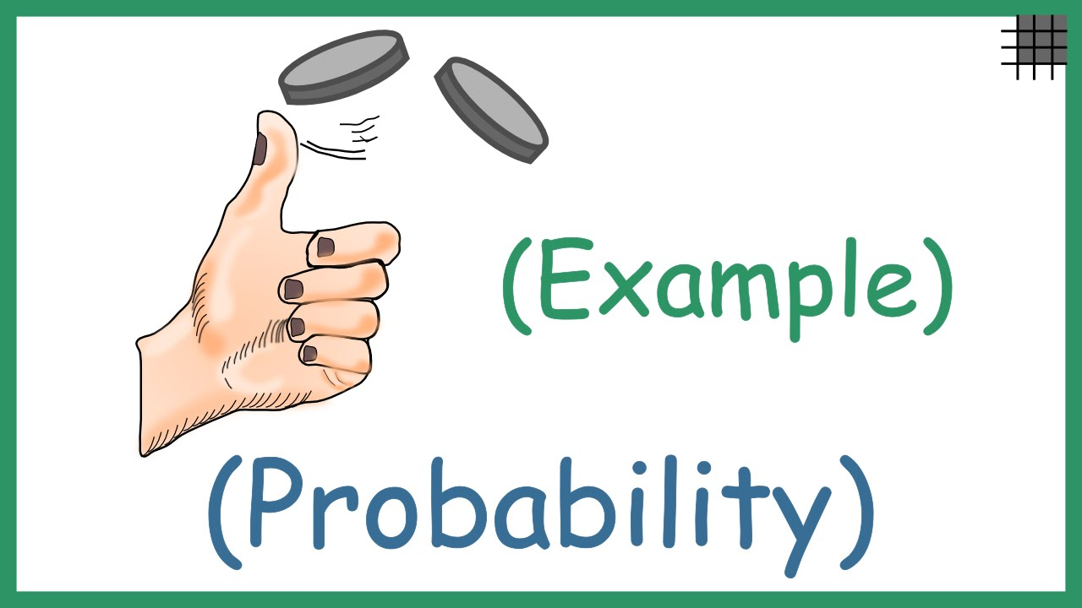
EXAMPLE: TOSSING A COIN

Slide 8
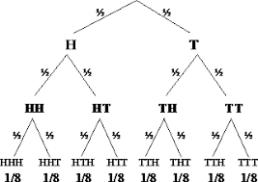

Slide 9
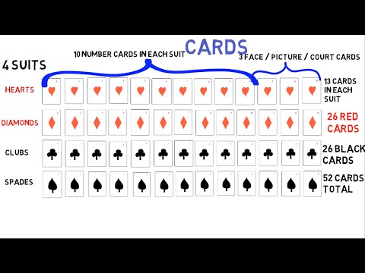
CARDS:

Slide 10

RANDOM VARIABLES AND DISTRIBUTION FUNCTIONS
All random variables (discrete and continuous) have a cumulative distribution function. It is a function giving the probability that the random variable X is less than or equal to x, for every value x. For a discrete random variable, the cumulative distribution function is found by summing up the probabilities.

Slide 11
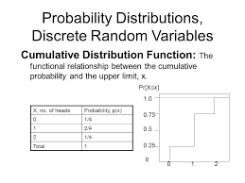

Slide 12

CORRELATION
What is Correlation?
Correlation is used to test relationships between quantitative variables or categorical variables In other words, it’s a measure of how things are related. The study of how variables are correlated is called correlation analysis.
Some examples of data that have a high correlation:
Your caloric intake and your weight.
Your eye color and your relatives’ eye colors.
The amount of time your study and your GPA.
Some examples of data that have a low correlation (or none at all):
the type of cereal you eat.
A dog’s name and the type of dog biscuit they prefer.
The cost of a car wash and how long it takes to buy a soda inside the station.

Slide 13
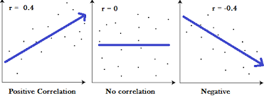

Slide 14
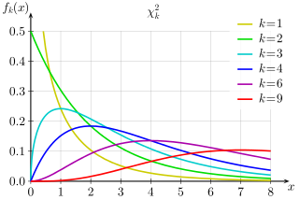
X DISTRIBUTION
2
By the central limit theorem, because the chi-squared distribution is the sum of k independent random variables with finite mean and variance, it converges to a normal distribution for large k . Specifically, if X ~ χ²(k) , then as k tends to infinity, the distribution of tends to a standard normal distribution.

Slide 15
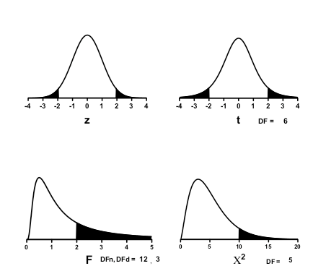
t , f and z DISTRIBUTION

Slide 16

TEST OF HYPOTHESIS
Testing H₀ at significance level α means testing H₀ with a test whose size does not exceed α . The probability, assuming the null hypothesis is true, of observing a result at least as extreme as the test statistic. Statistical significance test. A predecessor to the statistical hypothesis test .

Slide 17
